Slide 1
3D trigonometry

Slide 2
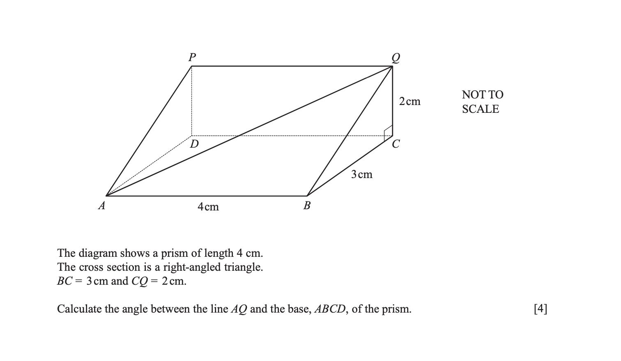

Slide 3
